Slide 1

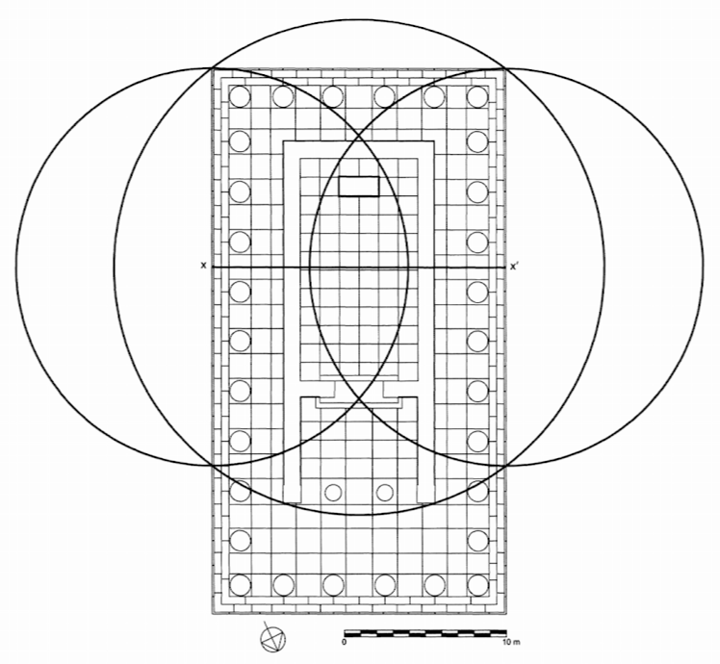
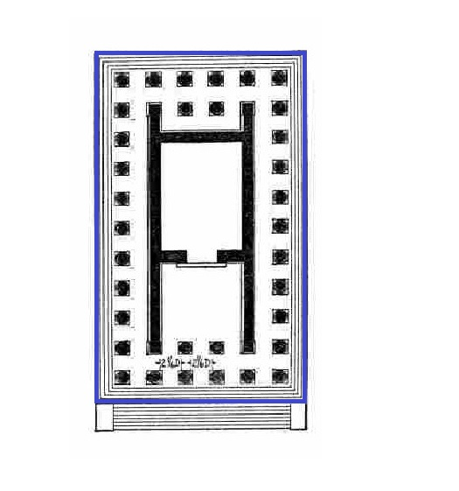
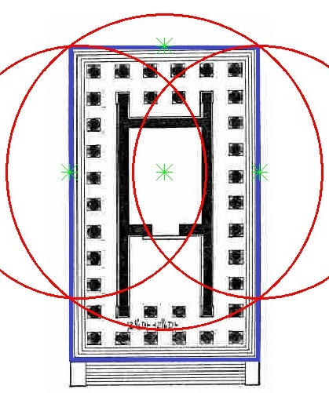
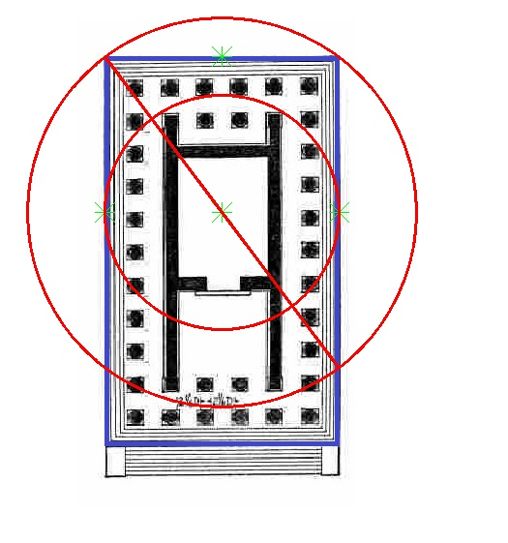
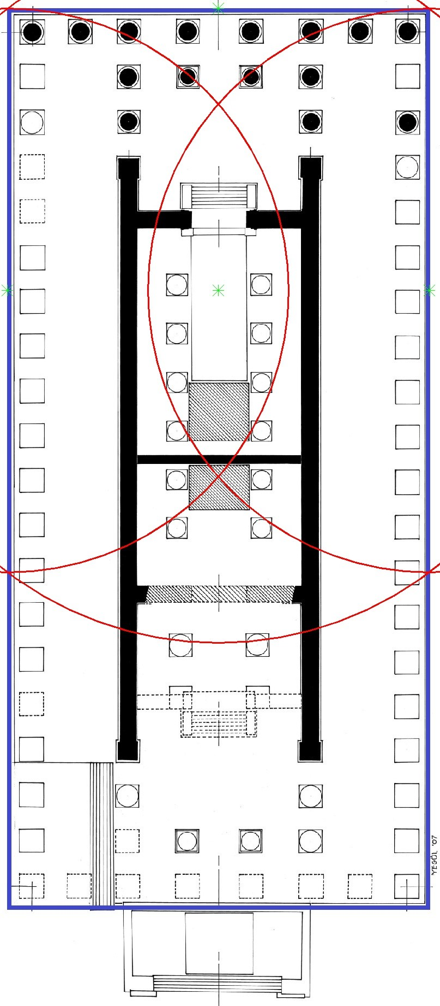
The Immortal Temple: A Digital Study of Hellenistic Architecture
Alex Kaminski
Mount Allison University
Background
Hypothesis
Following the momentum of Alexander the Great’s campaign (336-323 BC) and the consequent spread of Hellenism came a movement of highly intellectualized material culture within the Hellenistic Era (334 BC – 17AD). Among others, Greek architects began to conceive of designs that emphasized the representation of higher ideals, referencing Idealism found in the works of the philosopher Plato. He posited that the material world was a mere imitation of transcendental Forms that existed in an immortal world beyond ours which is only attainable by sound deliberation. Inspired by this, as an alternative to the grid-based design of the Doric tradition Architects sought to express Platonic Forms in terms of hierarchical geometric shapes that dictated the layout of principle features within their designs. These shapes were used to dictate principle features of several Hellenistic temples known to us today.
In 2007 a study was conducted by John R. Senseney PhD, investigating the layout of Temple A (Fig. 1). A Hellenistic temple built in honor of Asclepius, the God of Medicine, located on the Island of Kos off the coast of modern day Turkey. Using AutoCAD software to reconstruct the layout and calculations done by hand, Senseney analyzed the floor plan and found a circumscribed Pythagorean triangle served as the basis for its design instead of the Doric style. This revealed extensive proportional relationalities amongst temple features that exemplified Platonic Idealism. The temple’s architect, Hermogenes of Prienne (2nd-1st Century BC), is known to have designed two more temples and influenced others within the Hellenistic Period. The purpose of this project was to prove that he utilised the same method of design in these temples as well and to determine to what extent he might have influenced others.
C
C'
B
B'
A
Figure 1: Theoretical Plan of a restored Temple A with the primary overlay of geometric forms. The lengths of the Triangle follow the Pythagorean ratio of 3(A):4(B):5(C), the length of C serving as the radius for the central, larger circle and the length of B as the radius of the two smaller circles. Everything is calculated with respect to A, equal to half the width of the Temple.
Method of Procedure
From the methods outlined in Senseney’s study I developed a program using Python 3.6 to process temple layouts with their perimeters marked in blue (Fig. 2). Senseney begins at the center of the cella, most likely prioritized by architects as the site of offerings at altars, the point at which they feel closest to their gods. The program measures the marked images and superimposes geometric forms following the Pythagorean ratio, 3:4:5, relative to the value of A (half the width of the temple). In a temple without this design influence the shapes should not align with interior features. In a temple based on the Pythagorean triangle, the triangles drawn should correspond to internal features and make proportional relationalities readily observable. Several temples were processed, displayed here are two, one which Hermogenes was said to have designed, the Temple to Dionysus from Teos, and the Temple to Artemis from Sardis, which he is said to have influenced.
Figure 2: Annotated layout of a theoretical restoration of the Temple to Dionysus at Teos.
Results and Discussion
As depicted in Temple A (Fig. 1) parts of the circles derived from the Pythagorean Triangle correspond to key features in the layout of all three temples. In Figure 3, within a margin of error, the overlapping circles fit the dimensions of the cella. Relative to the offset of the circles, the length of the overlap is equal to the distance between the overlap and the outer edge on either side (Fig 3.I). Compared to the length of the center point to the same edge (Fig. 3.II) they form a 2:3 ratio. The central circle originating at the center of the cella intersects with the smaller circles at the back corners of the euthentyria and the antae at its front, their diameters at a 4:5 ratio. All together in relation to their respective widths, they form a 3:4:5 ratio, confirming that a Pythagorean Triangle conforming to this ratio serves as the basis for The Temple at Teos’ design.
The Temple to Artemis at Sardis (Fig. 4) bore many alterations over time, but its own cella was built during the Hellenistic period. The processed layout reveals some consistency in terms of relative widths similar to the Temple of Dionysus, the overlap is the same width of the cella and is consistent with the interior columns that were also built in the same period. The lateral offset puts the ends of the overlap away from the cella’s front and back entrance by the same upwards factor, most likely caused by the re-construction in the Roman Era. The columns supporting the back porch in antis possess fluted ends characteristic of the Hellenistic era but at their base are supported by unfinished blocks dating to the Roman Era, indicating a shift in length to create both the front and back porches. Despite these changes, the program indicated Hermogenes’ influence on the design in terms of the relative temple widths.
Figure 3: Images of the processed Temple to Dionysus (I and II respectively).
Conclusion
From the results of the study I was able to confirm that both of the Temples Hermogenes built, to Dionysus at Teos and Artemis at Magnesia, were designed using his circumscribed Pythagorean triangle method. Within a margin of error given the simplistic method of photo recognition in the program, the shapes generated were consistent with internal features of the temples he built, making proportional relationalities observable. I was able to argue that his influence can be reflected in further temples built in the Hellenistic period and perhaps survives undiscovered in more. The method of digital analysis used in this project has potential for further studies. The program devised can be expanded to further sequences of shapes based on Pythagorean ratios relative to different origin points within the temple. The program can be altered to process hundreds of temples quickly with significantly developed photo recognition.
Much knowledge of the Hellenistic period is lost to the intense warfare that permeated the landscape, but violence could not impede profound thought. This did not prevent the increased intellectualizing of architectural design and goes beyond textual analysis, representing a door to new perspectives. Perhaps like Temple A, when pushed past face value this method of digital analysis reveals a window into the minds of ancients, and does not serve as an end but as an invitation to delve deeper into them.
Figure 4: Processed layout of the Temple to Artemis at Sardis.
Key Sources
Jaspers, Karl. “Plato and Augustine.” The Great Philosophers, eeeeeeedited by Hannah Arendt, Vol. 1. Harcourt, Brace & World iiiiiiiiiiiiiInc.: New York, 2000.
Senseney, John R. “Idea and Visuality in Hellenistic Architecture.” hhhhhhhHesperia 76 (2007): 555-595.
Stamper, John W. The Architecture of Roman Temples. CCCCCCCambridge: University Press, 2005.
Yegül, Fikret. “The Temple of Artemis at Sardis.” Archaeological EEEEEEExploration of Sardis. 2017. http://sardisexpedition.org/en/essays/latw-yegul-temple-of-artemis#the-greco-roman-temple

